Slide 1
Antiparasitics
Pharmacology

Slide 2
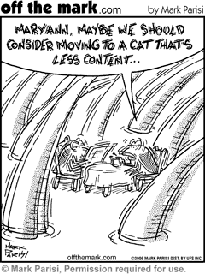
Parasites and Animal Disease
Parasitism is a relationship between two different organisms in which one of the organisms (parasite) benefits while the other (the host) is harmed
The harm inflicted depends on the health of the host and can range from minor illness to generalized impairment
Some parasitic infections can be zoonotic.

Slide 3
Parasites and Animal Disease
Parasites can be contracted by:
  Animal to animal contact
  Ingestion of contaminated food or water
  Insect transmission
  Direct contact with the parasite
    Walking, lying, or rolling on infected soil
Some parasites might not cause any clinical signs in the animal
Most intestinal parasites are diagnosed by microscopic fecal examinations
Some clinical signs may manifest before PPP.

Slide 4
Basic Terminology
Endoparasites live within the body of the host and cause internal parasite infections.
Ectoparasites live on the body surface of the host and cause external parasite infestations.
  Ectoparisiticides treat ectoparasites
  Anthelmintics treat worm infections
  Antiprotozoals treat protozoan parasite infections
  Endectocides treat internal parasitic infections and external parasitic infestations.

Slide 5
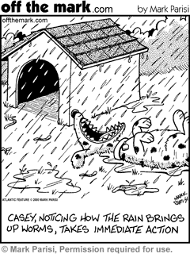
Endoparasites
Helminths are divided into two major groups:
  Nematodes: cylindrical, nonsegmented worms commonly called roundworms
  Platyhelminthes: flattened worms that are subdivided into two groups:
    Cestodes (tapeworms)
    Trematodes (flukes)
Anthelmintics kill worm parasites
  Antinematodals
  Anticestodals
  Antitrematodals

Slide 6
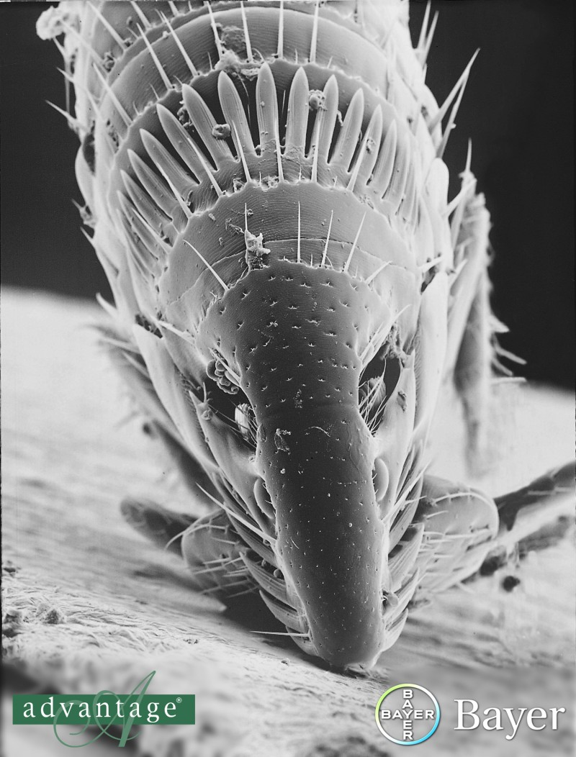
Ectoparasites
Fleas
Mosquitoes
Bots
Cuterebra
Lice
Flies
Arachnids
  Ticks
  Mites

Slide 7
Antinematodals
Benzimidazole drugs
Imidazothiazoles
Tetrahydropyrimidines
Organophosphates
Piperazine compounds
Macrocyclic lactones (Avermectins)

Slide 8
Benzimidazoles
Work by interfering with energy metabolism of the worm
Recognize by –azole ending in drug name
Always read the label to determine which parasites a drug is effective against
All can be administered orally, either as a paste, a granulated powder, or a solution.
Side effects are rare with benzimidaloles, but may include vomiting, diarrhea, and lethargy.

Slide 9
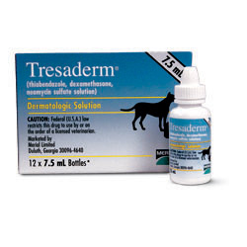
Thiabendazole
Effective against strongyles and ascarids
Also has antifungal and anti-inflammatory effects
Suitable for otic preparations such as Tresaderm®
  Tresaderm® also contains dexamethasone and neomycin sulfate
  Dexamethasone is a synthetic adrenocorticoid steroid that inhibits the reaction of connective tissue to injury and suppresses the classic inflammatory manifestations of skin disease.
  Neomycin is a broad-spectrum aminoglycoside

Slide 10
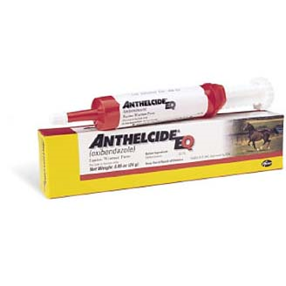
Oxibendazole
Used as a horse dewormer and in combination products for dogs.
Can cause liver toxicity in dogs
Anthelcide EQ Equine Wormer Paste ®
Mebendazole
A granular powder used in dogs and horses to treat ascarid, hookworm, and cestode infections.
Severe liver toxicity has been reported
Also used in humans for roundworms, pinworms, tapeworms, and hookworms
Telmintic®
  Approved for use in dogs; not cats; not dewormer of choice; safer alternatives are available.

Slide 11
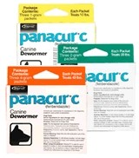
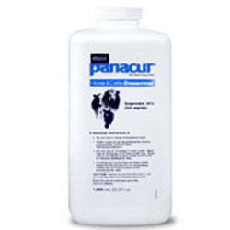
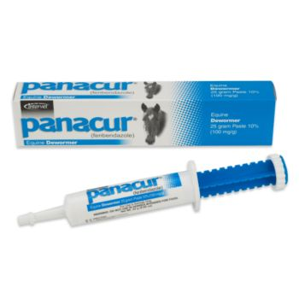
Fenbendazole
Wide spectrum of activity (roundworms, hookworms, whipworms, and Taenia pisiformis)
  Must be given for 3 consecutive days
Also used to treat metronidazole-resistant giardiasis.
Side effects include vomiting and diarrhea
Not approved for use in lactating dairy animals
Panacur® - available in granules, suspensions, and pastes.

Slide 12
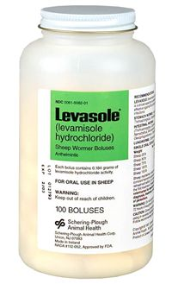
Imidazothiazoles
Work by stimulating the nematode’s cholinergic nervous system, leading to paralysis of the parasite (therefore, not ovicidal)
Effective against ascarids, strongyles, whipworms, and hookworms
Was used as a microfilaricide in the past
An example is levamisole (Levasol®)
  Expels most nematodes in 24 hours (some may be passed alive)
  Available in oral forms such as pellets, powder, suspensions, and pastes
  Also has anti-inflammatory and immunostimulant properties
  May cause toxicity in host animal due to cholinergic effects

Slide 13
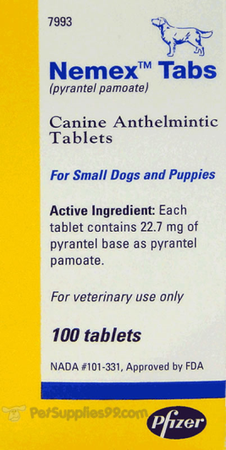
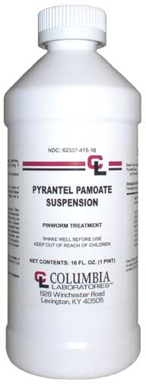
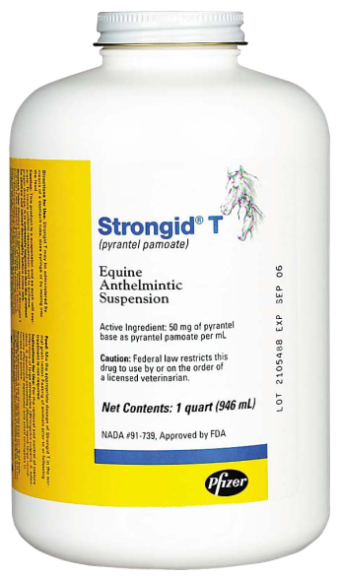
Tetrahydropyrimidines
Mimic the action of ACh and cause initial stimulation then paralysis of the worm
Effective against ascarids, pinworms, strongyles, and hookworms
Examples include pyrantel pamoate, pyrantel tartrate, and morantel tartrate
Taste = somewhat pleasant
Very safe.
Nemex®, Strongid-T®

Slide 14
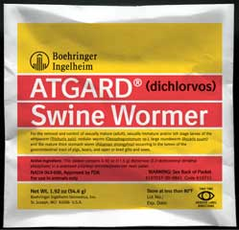
Organophosphates
Inhibit cholinesterase activity, causing ACh to remain active in the neuromuscular junction of the parasite
Are neurotoxic to parasites; some cause neurologic side effects in the host
Both endoparasitic and ectoparasitic
Narrow range of safety; not for use in heartworm-positive dogs
Effective against bots and a variety of nematodes
Dichlorvos (Task®)
Not safe to use OPs off-label!!!

Slide 15
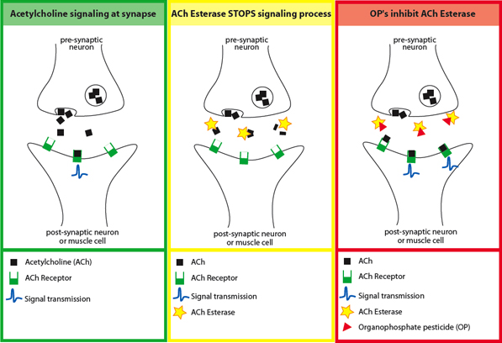
Side Effects of Organophosphate Poisoning
Salivation
Lacrimation
Urination
Dyspnea
Defecation
Emesis
Also ataxia, anxiety, abdominal pain, muscle twitching, pupillary constriction, seizures…

Slide 16
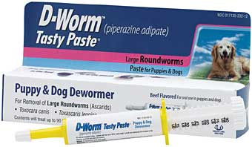
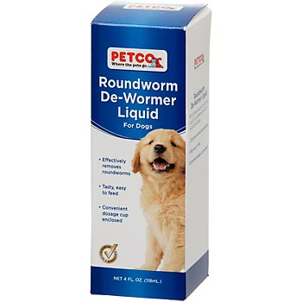
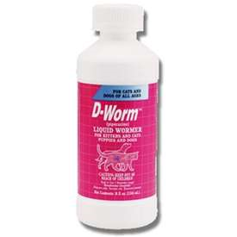

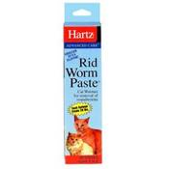
Piperazine
  Blocks neuromuscular transmission in the parasite
  Effective only against ascarids
  Clients should be made aware that piperazines often result in intact worms being vomited or passed in stool.
  Practically nontoxic
  Sold OTC
    Hartz Health Measures Once-a-Month Wormer® for Puppies
    Pipa-Tabs®

Slide 17
Macrocyclic Lactones
Avermectins (macrocyclic lactones)
  Bind to certain chloride channels in the parasite nerve and muscle cells, causing paralysis and death of the parasite
  The representative of this group is ivermectin, used for a wide variety of endo- and ectoparasites
    May be combined with other antiparasitic agents to broaden its spectrum of activity
    Heartgard Plus® (contains ivermectin and pyrantel pamoate)
  Oral (Heartgard®) and parenteral forms (Ivomec®) available
  Used for heartworm prevention
  Collies are ivermectin sensitive
  Another example in this group is moxidectin (ProHeart-6®, Advantage Multi®)
  Not effective against cestodes or trematodes

Slide 18
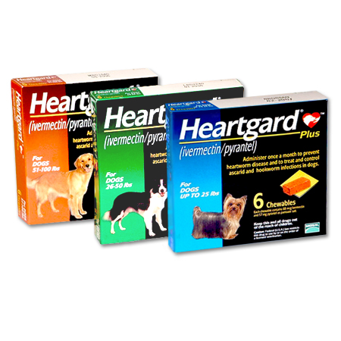
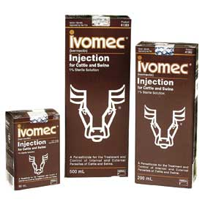
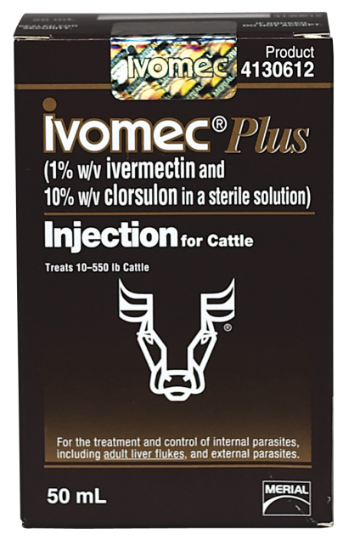
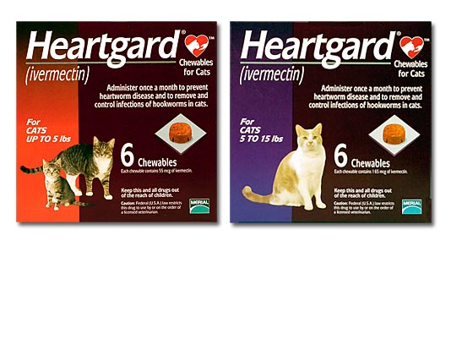
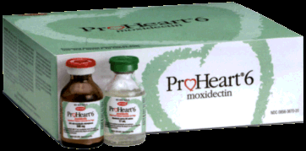

Slide 19
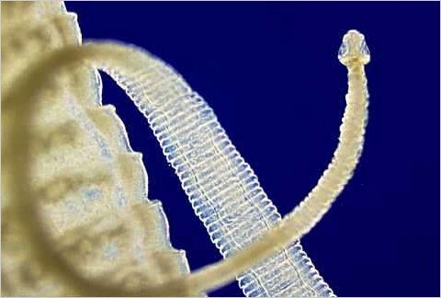
Anticestodals
Cestodes = “Tapeworms”
  Scolex, neck, proglottids
  Scolex attaches to intestinal wall
  Goal = scolex detachment
Some anticestodals are used in combination with antinematodal drugs.

Slide 20
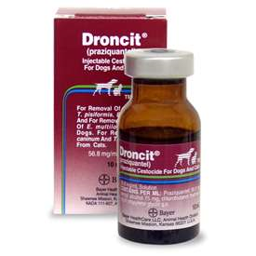
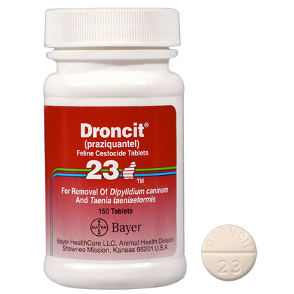
Anticestodals
Praziquantel (Droncit®)
  Works by increasing the cell membrane permeability of the cestode, thus reducing its resistance to digestion in the host’s intestinal tract. Ultimately, after administration of praziquantel, the entire tapeworm disintegrates (including the scolex).
  Owners will not see tapeworm or segments passed after treatment
  Works on all cestode species
  With Dipylidium caninum, it is especially important to also eradicate fleas to prevent reinfection.
  Available as oral tablet or injectable
  Side effects are rare; include anorexia, vomiting, diarrhea, and lethargy.

Slide 21
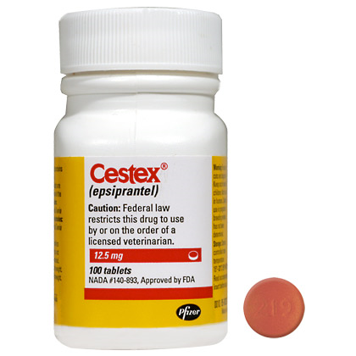
Anticestodals
Epsiprantel (Cestex®)
  Effective against Taenia spp. and Dipylidium caninum, but not Echinococcus spp.
  Like praziquantel, disintegrates cestode so that it can be digested by host
  Unlike praziquantel, not absorbed well by GI tract, so systemic side effects are minimal.
Fenbendazole
  A benzimidazole (covered previously – antinematodals)
  Effective against Taenia spp. but not Dipylidium caninum
  Unless other parasites are present in animal that can be treated with fenbendazole, praziquantel or epsiprantel are recommended.

Slide 22
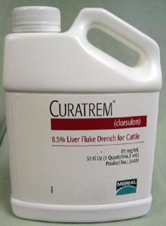
Antitrematodals
Clorsulon (Curatrem®)
  A benzene sulfonamide
  Works by inhibiting the trematode’s enzyme systems for energy production (robs fluke of energy)
  Effective against Fasciola hepatica
    Adult and immature forms
  OTC
  Drench
  Not recommended in dairy animals

Slide 23
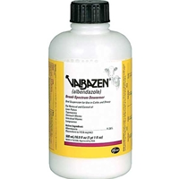
Antitrematodals
Albendazole (Albazen®)
  Benzimidazole that interferes with the energy metabolism of the worm
  Also effective against some nematodes (broad-spectrum)
  Not approved for use in lactating animals
Praziquantel
  Covered previously (anticestodal)
  Also effective against lung flukes in dogs and cats

Slide 24
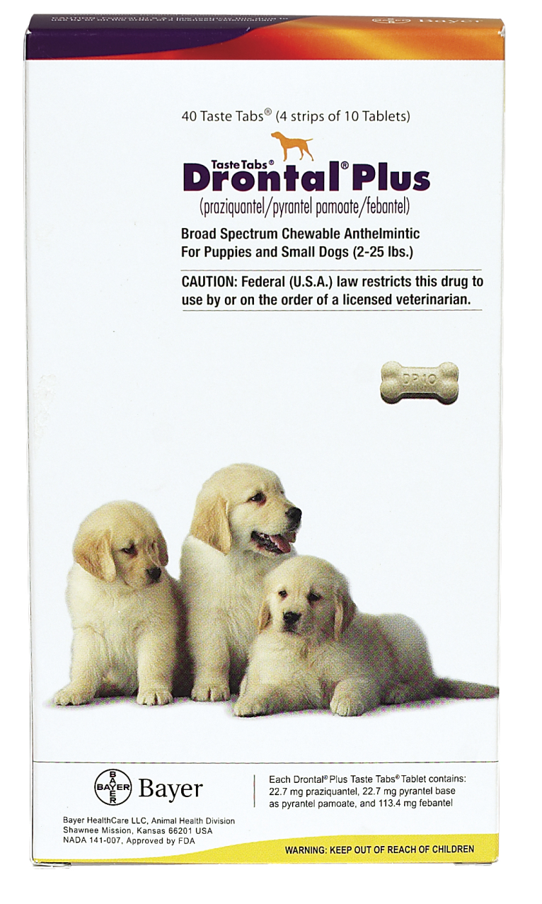
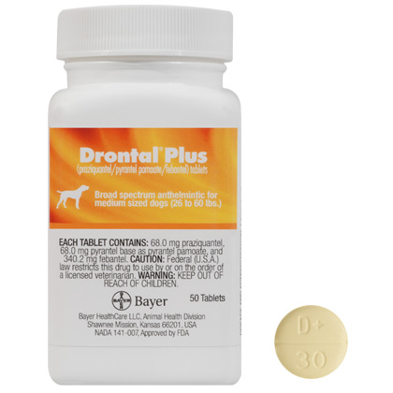
Drontal Plus®
Contains:
  Febantel, a probenzimidazole that is metabolized in the animal to a true benzimidazole.
    Effective against ascarids, strongyles, and pinworms
  Pyrantel pamoate
    Antinematodal
  Praziquantel
    Anticestodal
    Antitrematodal

Slide 25
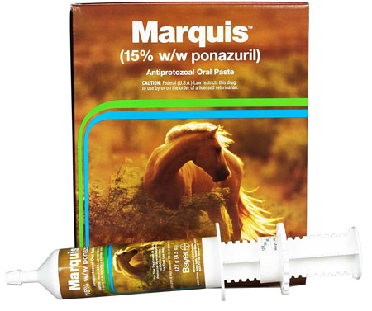
Anticoccidials
Coccidiosis is a protozoal infection that causes intestinal disorders
Most anticoccidial drugs are coccidiostats (do not actually kill the parasite, so hygiene is crucial)
Sulfadimethoxine (Albon®)
  Reduces the number of oocysts shed, thus reducing spread of disease
Ponazuril (Marquis®)
  Equine antiprotozoal oral paste ; used off-label in dogs/cats
  Kills coccidia
  Given in 3 doses – days 1, 2, and 9.
    30 mg/kg of a 50 mg/mL solution
Others (work mainly by affecting the protozoan’s metabolism)
  Nicarbazine, Amprolium, Monensin, Decoquinate, Robenidine

Slide 26
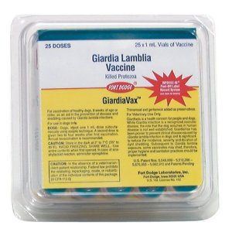
Antiprotozoals
Giardiosis is a protozoal disease caused by Giardia spp.
  Antiprotozoal drugs
    Metronidazole (Flagyl®) (enters the protozoal cell and interferes with its ability to function and replicate)
    Fenbendazole (Panacur®)
    Albendazole (Valbazen®)
  Giardia Vaccine (GiardiaVax®)
Blood protozoan Babesia sp. is transmitted by ticks
  Imidocarb (injectable) has cholinergic effects on the protozoan
  Tick prevention also important

Slide 27
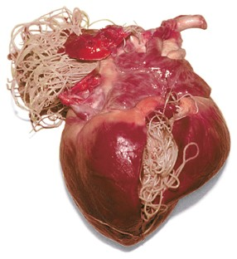
Heartworm Prevention and Treatment

Slide 28
Treatment of Heartworm Disease
Heartworm disease is caused by the filarial nematode Dirofilaria immitis
Three stages of management of heartworm disease
  Preventing third-stage larvae from reaching maturity (preventative)
  Adulticide therapy
  Eradication of circulating microfilariae after infection

Slide 29
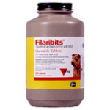
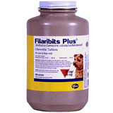
Treatment of Heartworm Disease
Preventing third-stage larvae from reaching maturity (preventative)
  Daily oral preventative
    Diethylcarbamazine (DEC) Filaribits®
      Given during mosquito season and two months after
      Anaphylactic shock and death can occur if given to dog with microfilaria
      Filaribits Plus® also controls ascarid infections (contains oxibendazole)

Slide 30
Monthly Oral Preventatives
Ivermectin – Heartgard®, Iverhart PlusTM, Tri-Heart PlusTM
  Macrocyclic lactones
  “Plus” products also contain pyrantel pamoate (hooks, rounds)
  Ages 6 months +
  Caution in collies
  Side effects include neurologic signs such as salivation, ataxia, and depression
Milbemycin oxime - Interceptor®
  Sentinel® = milbemycin oxime + lufenuron
  Also effective against hookworms, roundworms, and whipworms and Demodex mites in dogs.

Slide 31
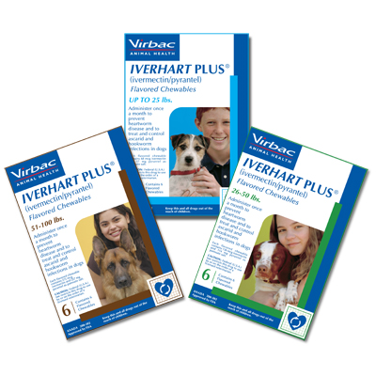
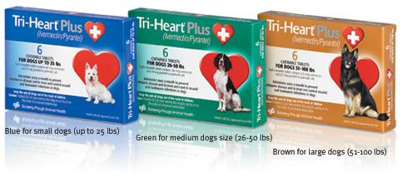

Slide 32
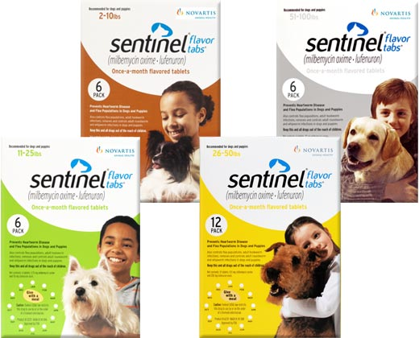
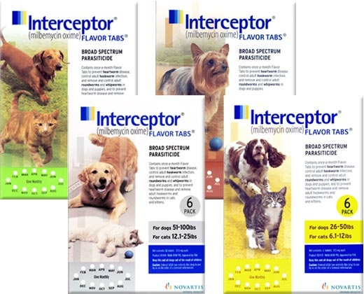

Slide 33
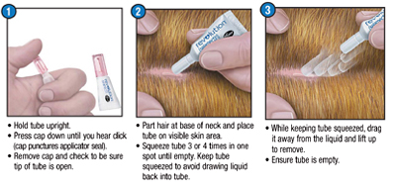
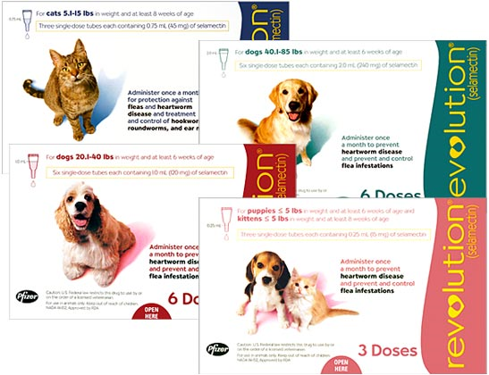
Monthly Topical Preventatives
Selamectin - Revolution®
  Absorbed systemically
  Dogs: heartworm, fleas, ticks, ear mites, sarcoptic mange
  Cats: heartworm, fleas, ear mites, roundworms, hookworms

Slide 34
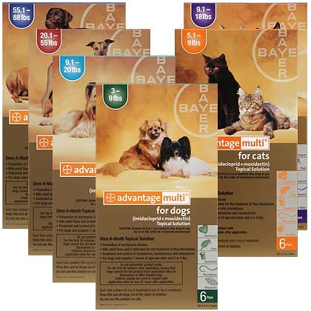
Moxidectin + imidacloprid = Advantage Multi®
  Heartworm prevention, Flea control, Intestinal parasite prevention
  Children should not come in contact with application site within 30 minutes of administration
  Do not use on sick, debilitated, or underweight animals

Slide 35
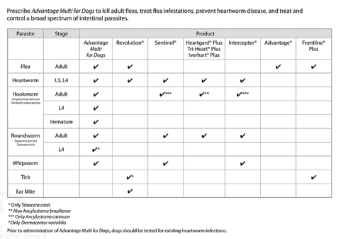
Parasite Preventatives in Dogs

Slide 36
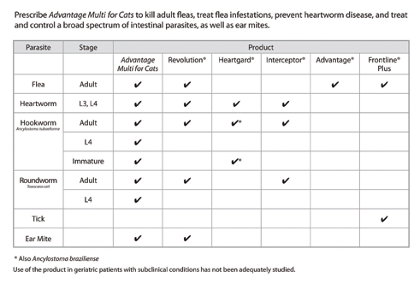
Parasite Preventatives in Cats

Slide 37
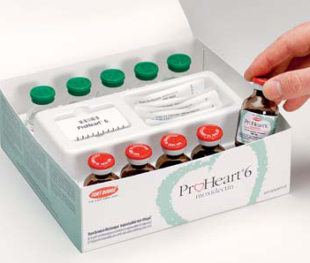
Six-month Injectable Preventative
Moxidectin - Proheart®
  Side effects include neurologic and gastrointestinal signs
  Withdrawn from the market in September 2004 due to increased reports of adverse side effects including liver and bleeding abnormalities.
  Reformulated and reintroduced in 2008.
  Owners must sign a special “Informed Consent” form

Slide 38
Treatment of Heartworm Disesase
Adulticide therapy
  Melarsomine - Immiticide®
    Given in the epaxial muscles BETWEEN L3 & L5
    Arsenic compound
    Less toxic than former drug (Caparsolate® - thiacetarsamide)
    Side effects include coughing, gagging, and lethargy
    Nephrotoxicity and hepatotoxicity have been reported.
    Not recommended for animals with caval syndrome (large numbers of adult heartworms in the right ventricle, right atrium, and vena cava).

Slide 39
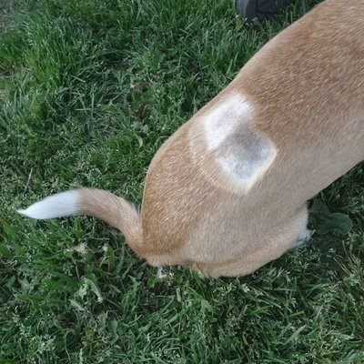
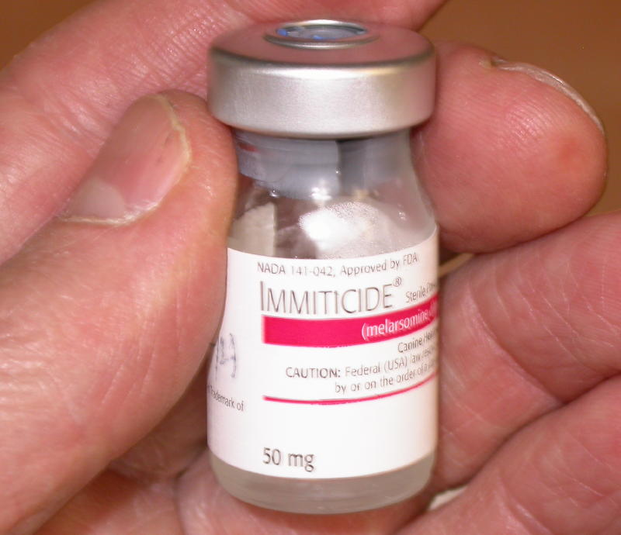
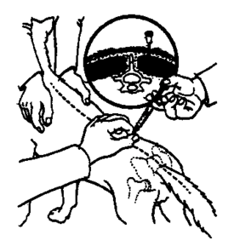

Slide 40
Treatment of Heartworm Disease
Eradication of circulating microfilariae after infection
  Ivermectin (most common)
    Given at higher dose as a microfilaricide
    Monitor for neurologic side effects
    Should kill microfilaria in ~3 weeks
  Milbemycin oxime
  Levamisole (infrequently used)
    Given for 1 week or longer depending on dosage.

Slide 41
Ectoparasite Treatment

Slide 42
Ectoparasite Treatment
Ectoparasites can be controlled using a variety of different drugs in a variety of different formulations
  Sprays
  Dips
  Pour-ons
  Shampoos
  Dusts or powders
  Foggers
  Oral products
  Spot-ons
  Injectables
Refer to Table 15-4 in your textbook for forms of ectoparasites and their advantages/disadvantages

Slide 43
Chemicals Used for Ectoparasite Treatment
The chemicals used in ectoparasite treatment are summarized in Table 15-5 in your textbook
Always read product labels to determine what safety procedures to follow
May need protective clothing
May need special disposal techniques
Proper ventilation is crucial
Most regulated by EPA
Keep and refer to MSDS prior to use and if signs of toxicity occur in the animal

Slide 44
Chemicals Used for Ectoparasite Treatment
  Chlorinated Hydrocarbons
  Organophosphates
  Carbamates
  Pyrethrins and pyrethroids
  Formamidines
  Imidacloprid
  Fipronil
  Nitenpyram
  Insect Growth Regulators
  Insect Repellents
  Rotenone
  D-limonene

Slide 45

Chlorinated Hydrocarbons
One of the oldest groups of synthetic insecticides.
Reduced usefulness in veterinary medicine
Resistant to biodegredation (remain in environment for years)
Includes DDT (dichlorodiphenyltrichloroethane)
People who use C.H. must be certified to apply them.
Applied to plants/animals to control insects, eventually washed into streams. High lipid solubility allows accumulation in fish. Affects are more intense higher up food chain.
Decline of bald eagle population traced to fragile egg shells as a result of biological magnification of DDT.

Slide 46

Lindane
The only chlorinated hydrocarbon currently used in veterinary medicine today.
Incorporated in some dog shampoos.
Kills insects on contact; directly absorbed into insects and their eggs; also a stomach poison for insects
Can produce harmful side effects in people and pets if absorbed in sufficient quantities.
Owners should wear gloves, apron, boots
Dispose of empty bottles and bath water according to EPA policies
Lindane should never be used on cats, puppies <3 weeks, lactating animals, or food animals.

Slide 47
Organophosphates & Carbamates
Decompose readily in environment; do not pose threat to wildlife.
Among the most widely used of the potent insecticides.
Also have agricultural applications.
General names for a broad class of insecticides
Bind to acetylcholinesterase, allowing Ach to continue to stimulate receptor sites.
Clinical signs of toxicity depend on which Ach receptor is stimulated most (nicotinic or muscarinic)

Slide 48
Organophosphates & Carbamates
SLUDDE and miosis (pinpoint pupils) = classic signs of muscarinic overstimulation
Nicotinic receptors primarily located where nerves contact muscles; overstimulation produces muscle tremors that progress to paralysis (ataxia, loss of motor control).
Delayed neurotoxicity syndrome has been reported in people, cats, dogs, and livestock; occurs 1-2 weeks after short-term exposure to large doses of some Ops.

Slide 49
Organophosphates & Carbamates
Persian cats, sick cats, Whippets, Greyhounds, and certain exotic breeds of cattle are sensitive to Ops.
As a general rule, these insecticides should not be used on animals recovering from surgery, sick animals, pregnant animals, or animals considered to be stressed.
Found in sprays, dips, dusts, and systemic medications
Carbamates also found in collars and shampoos
With oral products, fleas must bite animal to get medication

Slide 50
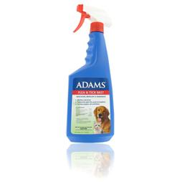



Organophosphates & Carbamates
Adam’s Flea and Tick Dip®, Spray®, and Tick Dust®
Carbaryl (Mycodex shampoo with carbaryl®)
Sevin Dust®
Cythioate (Proban® tablets and liquid)
Diazinon (Escort®)
Phosmet (Paramite dip®)

Slide 51


Pyrethrins and Pyrethroids
Pyrethrins are natural plant products, derived from chrysanthemum flowers
Pyrethroids are synthetic pyrethrins
Very safe; quick kill
Adulticide, insecticide/miticide
Often manufactured with other products such as imidacloprid and pyriproxyfen
Acts on parasite’s nerve cell membrane to disrupt sodium channel, which delays polarization and paralyzes the parasite

Slide 52
Pyrethrins and Pyrethroids
May have limited residual effects
Do not use near lakes, ponds, streams (fish easily poisoned with pyrethrins; absorbed through skin)
Form labeled for dogs may be too high of concentration for cats
Used in small animals primarily for fleas/ticks
Used in large animals for flies, lice, mites, mosquitos, and ticks
Commonly used in sprays, dips, foggers, pour-ons, insecticidal ear tags, and premise sprays.

Slide 53


Pyrethrins and Pyrethroids
Recognizable by –thrin suffix
Include resmethrin (degraded by UV light), allethrin, permethrin, tetramethrin, bioallethrin and fenvalerate.
Permethrin has been incorporated into some external antiparasitic protocols because of its effectiveness in killing and repelling fleas and ticks.
K9 Advantix, Bio-Spot® for dogs

Slide 54
Formamidines: Amitraz
One of the first effective agents available for demodectic mange in dogs.
Causes excessive adrenergic activity in parasite’s nervous system
Toxic to cats and rabbits
Animals may show sedation and incoordination for 24-48 hours after application
Available in collars, topical treatment, dip, or sponge-on bath.
Use protective clothing and gloves; use in a well-ventilated area

Slide 55



Amitraz
ProMeris® for dogs (synergistic with metaflumizone)
Mitaban Dip®
PrevenTIC® collar
Taktic®EC (cattle)

Slide 56

Amitraz
Can be very toxic if ingested by animals or people
Amitraz toxicosis is treated with supportive therapy and multiple doses of Yohimbine or Atipamezole (alpha-2 receptor antagonists).
Taktic has been advocated for some nonresponsive cases of demodectic mange in dogs as an extra-label therapy. Owners must be well informed of potential risks of this treatment.

Slide 57

Imidacloprid
Advantage®
Insect neurotoxin; blocks receptor site for Ach, thereby blocking transmission of the impulse across the synapse.
Marketed for use in both dogs and cats.
Poorly absorbed through skin and kills adult fleas on contact
Wide margin of safety.
Four week residual activity.

Slide 58

Fipronil
Frontline®
Fipronil with methoprene (Frontline plus®)
Interferes with chloride channels of insects, which overstimulates their nervous system causing death
Adult fleas, ticks, and chewing lice (on contact); controls sarcoptic mange with repeated treatments.
Methoprene is an insect growth regulator, which makes Frontline plus® effective against flea eggs and larvae.
Applied topically; not absorbed systemically
Residual activity, even after bathing
Not for use in puppies or kittens <8 weeks of age.

Slide 59

Fipronil
Also marketed as a measured-dose spray product that is applied at a dose of 3 ml/kg body weight.
Container is calibrated to administer precise amount of insecticide to allow accurate dosing.
Manufacturer claims that fipronil is unlikely to produce toxicity even if consumed orally.
Fipronil binds with the dermis, hair follicles, and sebaceous glands.

Slide 60

Nitenpyram
Capstar®
Binds and inhibits nicotinic (Ach) receptors
Tablet begins to kill adult fleas within 30 minutes
At least 90% fleas killed in 4 hrs. (dogs); 6 hrs. (cats)
Can safely give a dose as often as one per day
Can use on puppies and kittens older than 4 weeks and weighing more than 2 lb.
Only kills adult fleas; should also give insect growth regulator (IGR) to control fleas.

Slide 61
Insect Growth Regulators
Insect growth regulators are compounds that affect immature stages of insects and prevent maturation to adults.
Include Insect development inhibitors and juvenile hormone mimics
Insect development inhibitors interfere with development of chitin, which is essential for proper egg formation and development of the larval exoskeleton. The “egg-tooth” used by flea larvae to exit egg is also made of chitin.

Slide 62
Insect Growth Regulators
Juvenile hormone mimics prevent fleas from molting to the next stage by interrupting normal molting process. (Fleas need low levels of JH to molt to the next stage; these products mimic the flea’s natural JH) The insect stays in the larval stage and eventually dies.
Insect growth regulators do not affect adult fleas.
Lufenuron, methoprene, fenoxycarb, and pyriproxyfen are all IGRs.

Slide 63

Lufenuron
Program®
The flea component in Sentinel®
Interferes with chitin synthesis in flea development
Given orally to dogs; orally or SQ to cats
Fleas must bite the animal to be exposed to the drug.
Fleas continue to lay eggs, but eggs fail to develop normally.
Lufenuron is distributed to fat and then leaches slowly back into the body fluids, providing a long duration of activity; therefore drug needs to be given only once monthly.

Slide 64

Other IGRs
Methoprene (Ovitrol®) is generally regarded as safe. It is found (sometimes as ‘Precor’) in sprays, topical products, and flea collars.
  Female flea absorbs compounds from skin of animal (deposited by flea collar) and it is incorporated into eggs
  Flea pupae in carpet are protected from methoprene because it binds to fibers in carpet.
Pyriproxyfen (Nylar®) - Mostly used in environmental flea control products; may have some activity against adult fleas (but not immediate); more potent than methoprene and fenoxycarb
Fenoxycarb was voluntarily withdrawn from the market by the manufacturer in 1996 because of concerns over the results of government testing involving the use of high doses. It breaks down to formaldehyde, a carcinogen.

Slide 65
Insect Repellents
Used to repel insects and keep them off of animals
May be used in combination with pyrethrins and pyrethroids
Include sprays, ear tags, and topicals for ear tips
Some products are insecticides as well as repellents
Control mosquitoes, flies, and gnats.
DEET (Blockade® - Hartz) Combination with fenvalerate; was withdrawn from market for several months because of reports that it caused death in several cats and dogs. Signs of DEET toxicosis include: excitation, tremors, seizures, ataxia, and vomiting.

Slide 66
Insect Repellents
Butoxypropylene glycol (Butox PPG ® or VIP® Fly Repellent)
  Used in equine fly repellents because it provides a shine that is of cosmetic value in show animals
  Incorporated into flea and tick spray products for use in dogs and cats
  Can cause dermal irritation if a harness or collar is applied over the area while the haircoat is still wet with spray.

Slide 67
Other External Antiparasitics
Rotenone - A.k.a. “Derris Powder” (derived from derris root)
  Ear Miticide®, Mitaplex-R®
  Used in dips and pour-on liquids
  Toxic to fish and swine; consider runoff possibilities when using.
D-limonene (VIP Flea Dip and Shampoo®)
  Derived from citrus peels
  Has slight insecticidal activity
  Pleasant smell; provides quick kill; may be used with other products

